Slide 1
CS2009 Design and Analysis of Algorithms
Geometric Algorithms

Slide 2
Operations
primitive operations
convex hull
closest pair
voronoi diagram

Slide 3
Applications
VLSI design
Computer vision
Mathematical models
Astronomical simulation
Geographic information systems
Computer graphics (movies, games, virtual reality)
Models of physical world (maps, architecture, medical imaging).

Slide 4
Point: two numbers (x, y)
Line: two numbers a and b [ax + by = 1]
Line segment: two points
Polygon: sequence of points

Slide 5
Primitive operations
Is a point inside a polygon?
Compare slopes of two lines
Distance between two points
Do two line segments intersect?
Given three points p1, p2, p3, is p1-p2-p3 a counterclockwise turn?

Slide 6
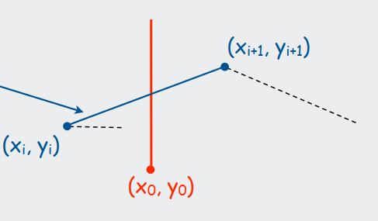
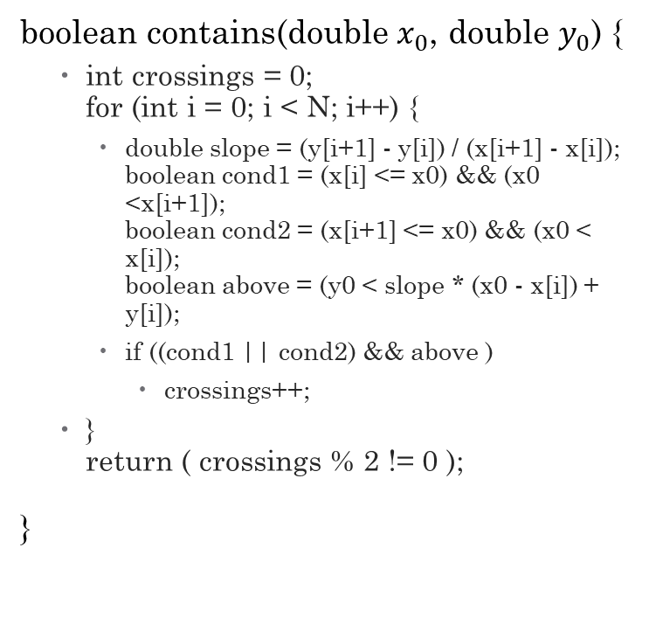

Does line segment intersect ray?
$Y=\frac{Y_{i+1}−Y_{i}}{X_{i+1}−X_{i}}\left(X_{0}−X_{i}\right)+Y_{i}$
$x_{i}≤x_{0}≤x_{i+1}$
boolean contains(double $x_{0}$, double $y_{0}$) {
int crossings = 0; for (int i = 0; i < N; i++) {
double slope = (y[i+1] - y[i]) / (x[i+1] - x[i]); boolean cond1 = (x[i] <= x0) && (x0 <x[i+1]); boolean cond2 = (x[i+1] <= x0) && (x0 < x[i]); boolean above = (y0 < slope * (x0 - x[i]) + y[i]);
if ((cond1 || cond2) && above )
crossings++;
} return ( crossings % 2 != 0 );
}

Slide 7
Implementing CCW
CCW. Given three point a, b, and c, is a-b-c a counterclockwise turn?
• Analog of comparisons in sorting.
• Idea: compare slopes.
Lesson. Geometric primitives are tricky to implement.
• Dealing with degenerate cases.
• Coping with floating point precision.
Implementing CCW

Slide 8
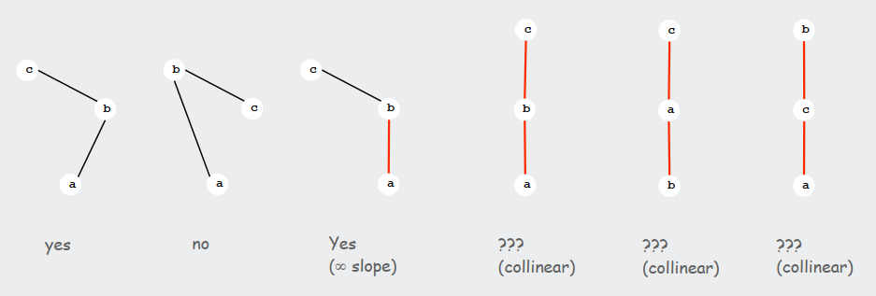
Implementing CCW…

Slide 9
CCW: Implementation
CCW. Given three point a, b, and c, is a-b-c a counterclockwise turn?
Determinant gives twice area of triangle.
If area > 0 then a-b-c is counterclockwise.
If area < 0, then a-b-c is clockwise.
If area = 0, then a-b-c are collinear.

Slide 10
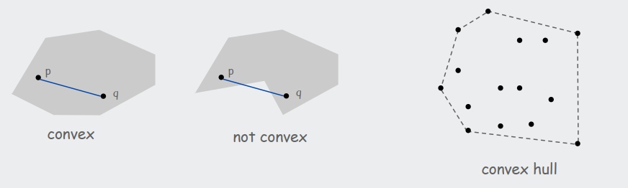
Convex Hull
A set of points is convex if for any two points p and q in the set, the line segment pq is completely in the set.
Convex hull. Smallest convex set containing all the points.
Properties
"Simplest" shape that approximates set of points.
Shortest (perimeter) fence surrounding the points.
Smallest (area) convex polygon enclosing the points.

Slide 11
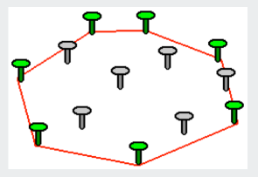
Mechanical algorithm
Hammer nails perpendicular to plane;
stretch elastic rubber band around points

Slide 12
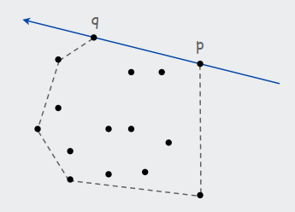
Brute-force algorithm
Observation 1:
Edges of convex hull of P connect pairs of points in P.
Observation 2
p-q is on convex hull if all other points are counterclockwise of pq.
O(N3) algorithm
For all pairs of points p and q in P
compute ccw(p, q, x) for all other x in P
p-q is on hull if all values positive

Slide 13
Package Wrap (Jarvis March)
Package wrap
Start with point with smallest y-coordinate.
Rotate sweep line around current point in ccw direction.
First point hit is on the hull.
Repeat.

Slide 14
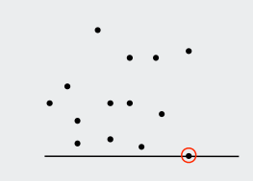
Package Wrap
Algorithm
Execution
Start with point with smallest y-coordinate.
Rotate sweep line around current point in ccw direction.
First point hit is on the hull.
Repeat.

Slide 15
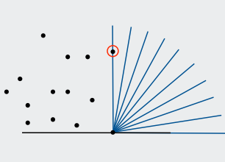
Package Wrap
Algorithm
Execution
Start with point with smallest y-coordinate.
Rotate sweep line around current point in ccw direction.
First point hit is on the hull.
Repeat.

Slide 16
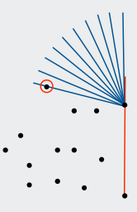
Package Wrap
Algorithm
Execution
Start with point with smallest y-coordinate.
Rotate sweep line around current point in ccw direction.
First point hit is on the hull.
Repeat.

Slide 17
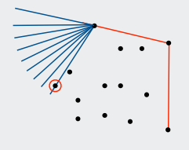
Package Wrap
Algorithm
Execution
Start with point with smallest y-coordinate.
Rotate sweep line around current point in ccw direction.
First point hit is on the hull.
Repeat.

Slide 18
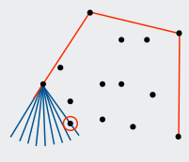
Package Wrap
Algorithm
Execution
Start with point with smallest y-coordinate.
Rotate sweep line around current point in ccw direction.
First point hit is on the hull.
Repeat.

Slide 19
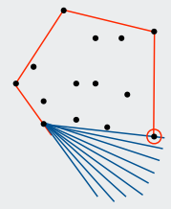
Package Wrap
Algorithm
Execution
Start with point with smallest y-coordinate.
Rotate sweep line around current point in ccw direction.
First point hit is on the hull.
Repeat.

Slide 20

Package Wrap
Implementation.
Compute angle between current point and all remaining points.
Pick smallest angle larger than current angle.
$Θ(N)$ per iteration.

Slide 21
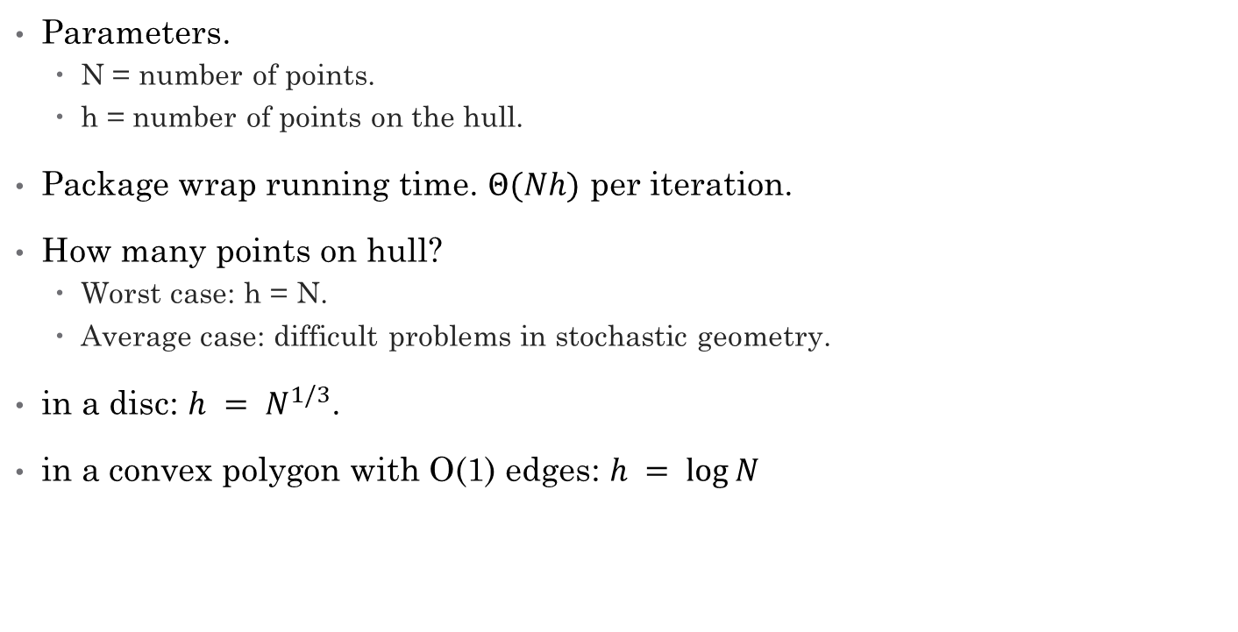
How Many Points on the Hull?
Parameters.
N = number of points.
h = number of points on the hull.
Package wrap running time. $Θ(Nh)$ per iteration.
How many points on hull?
Worst case: h = N.
Average case: difficult problems in stochastic geometry.
in a disc: $h = N^{1/3}$.
in a convex polygon with O(1) edges: $h = log⁡N$

Slide 22
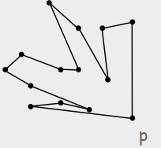
Graham Scan
Algorithm
Example
Choose point p with smallest y-coordinate.
Sort points by polar angle with p to get simple polygon.
Consider points in order, and discard those that would create a clockwise turn.

Slide 23
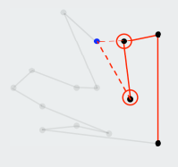
Graham Scan
Algorithm
Example
Choose point p with smallest y-coordinate.
Sort points by polar angle with p to get simple polygon.
Consider points in order, and discard those that would create a clockwise turn.

Slide 24
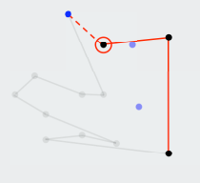
Graham Scan
Algorithm
Example
Choose point p with smallest y-coordinate.
Sort points by polar angle with p to get simple polygon.
Consider points in order, and discard those that would create a clockwise turn.

Slide 25
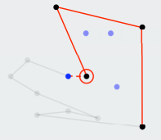
Graham Scan
Algorithm
Example
Choose point p with smallest y-coordinate.
Sort points by polar angle with p to get simple polygon.
Consider points in order, and discard those that would create a clockwise turn.

Slide 26
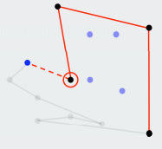
Graham Scan
Algorithm
Example
Choose point p with smallest y-coordinate.
Sort points by polar angle with p to get simple polygon.
Consider points in order, and discard those that would create a clockwise turn.

Slide 27
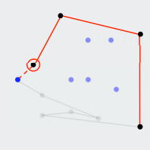
Graham Scan
Algorithm
Example
Choose point p with smallest y-coordinate.
Sort points by polar angle with p to get simple polygon.
Consider points in order, and discard those that would create a clockwise turn.

Slide 28
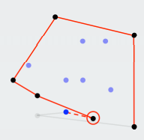
Graham Scan
Algorithm
Example
Choose point p with smallest y-coordinate.
Sort points by polar angle with p to get simple polygon.
Consider points in order, and discard those that would create a clockwise turn.

Slide 29
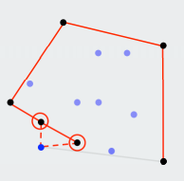
Graham Scan
Algorithm
Example
Choose point p with smallest y-coordinate.
Sort points by polar angle with p to get simple polygon.
Consider points in order, and discard those that would create a clockwise turn.

Slide 30
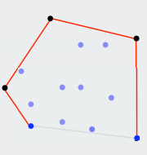
Graham Scan
Algorithm
Example
Choose point p with smallest y-coordinate.
Sort points by polar angle with p to get simple polygon.
Consider points in order, and discard those that would create a clockwise turn.

Slide 31
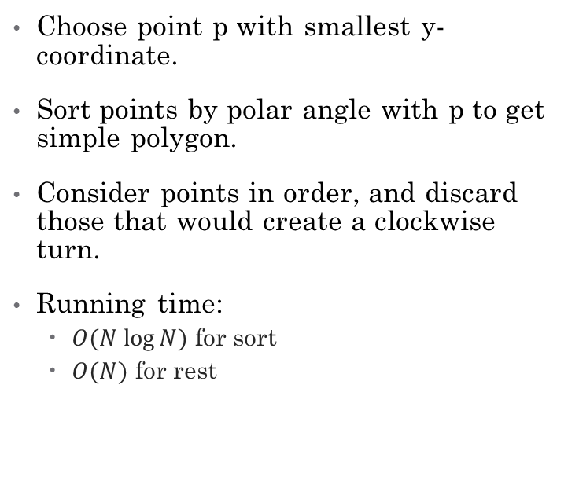
Graham Scan
Algorithm
Implementation
Choose point p with smallest y-coordinate.
Sort points by polar angle with p to get simple polygon.
Consider points in order, and discard those that would create a clockwise turn.
Running time:
$O(N log⁡N)$ for sort
$O(N)$ for rest
preprocess so that p[1] has smallest y-coordinate
sort by angle with p[1]
points[0] = points[N]; // sentinel
int M = 2;
for (int i = 3; i <= N; i++) {
while (Point.ccw(p[M-1], p[M], p[i]) <= 0)
M--;
M++;
swap(points, M, i);
}

